Slide 1
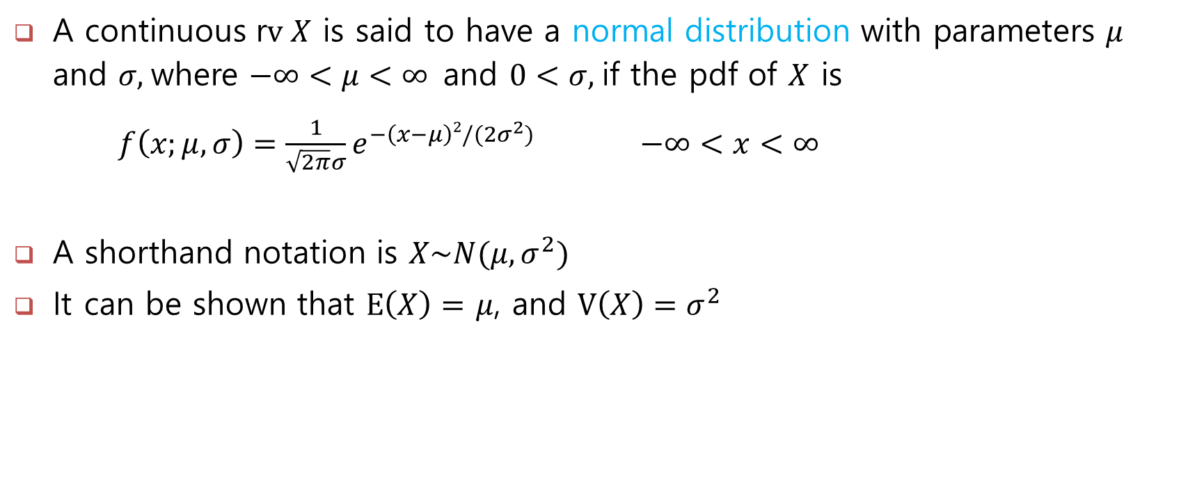
The normal distribution
A continuous r$v X$ is said to have a normal distribution with parameters $μ$ and $σ,$where $−∞<μ<∞$and $0<σ,$if the pdf of $X$ is
$f\left(x;μ,σ\right)=\frac{1}{\sqrt{2π}σ}e^{−\left(x−μ\right)2/(2σ^{2})}$ $−∞<x<∞$
A shorthand notation is $X\sim N(μ, σ^{2})$
It can be shown that $E\left(X\right)=$ $μ$, and $V\left(X\right)=σ^{2}$

Slide 2
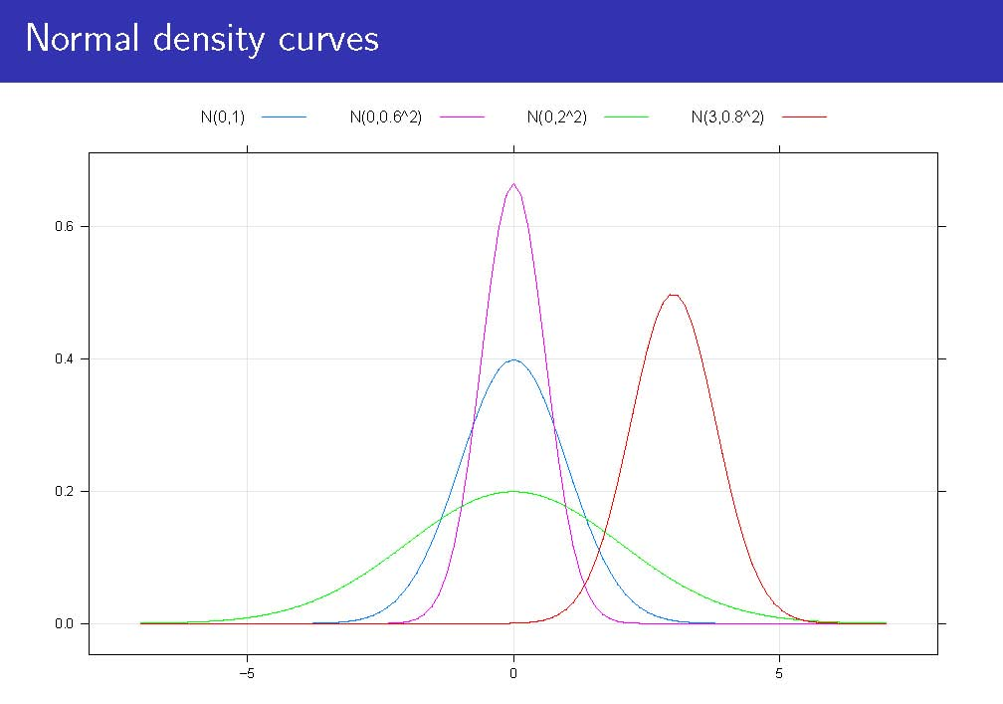

Slide 3
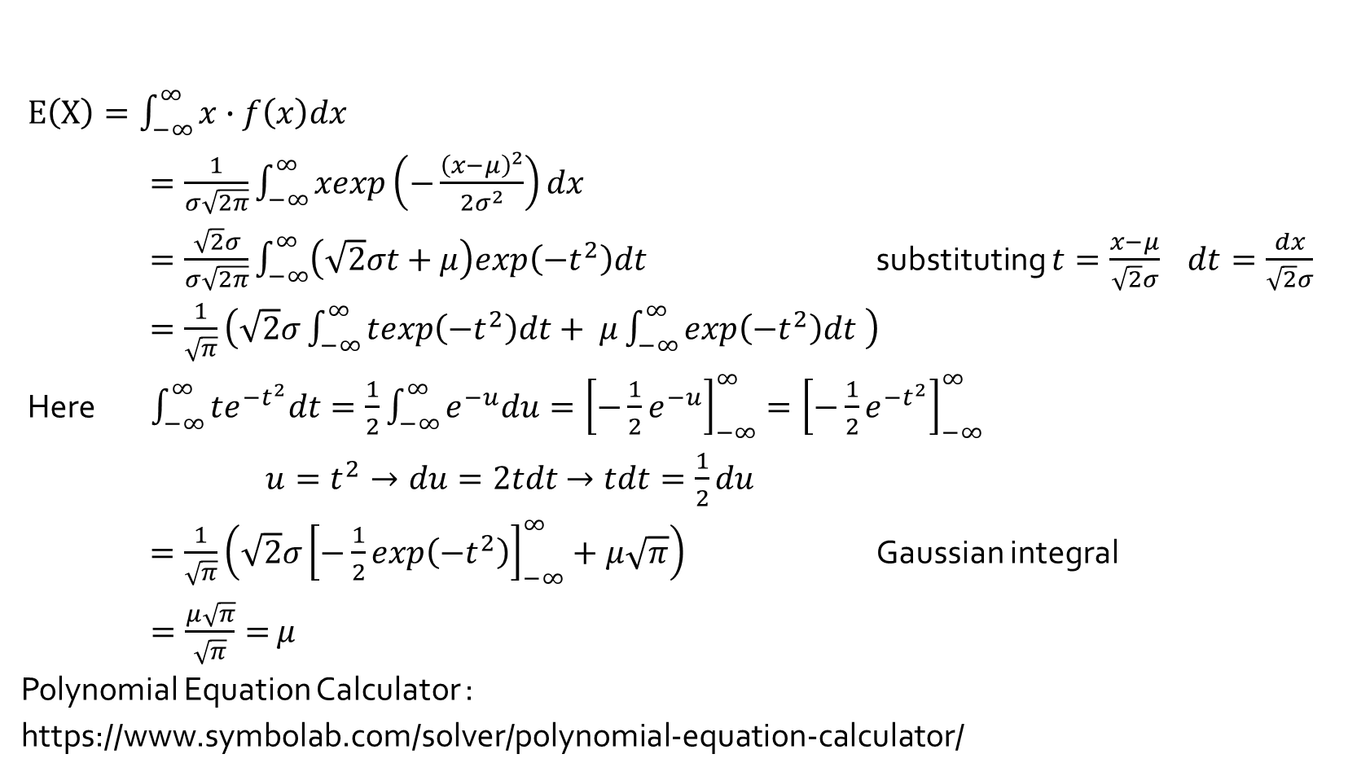
Mean of Normal Distribution**
$E\left(X\right)=\int_{−∞}^{∞}{x∙f\left(x\right)dx}$
$=\frac{1}{σ\sqrt{2π}}\int_{−∞}^{∞}{xexp\left(−\frac{{\left(x−μ\right)}^{2}}{2σ^{2}}\right)dx }$
$=\frac{\sqrt{2}σ}{σ\sqrt{2π}}\int_{−∞}^{∞}{\left(\sqrt{2}σt+μ\right)exp\left(−t^{2}\right)dt }$ substituting $t=\frac{x−μ}{\sqrt{2}σ} dt=\frac{dx}{\sqrt{2}σ}$
$=\frac{1}{\sqrt{π}}\left(\sqrt{2}σ\int_{−∞}^{∞}{texp\left(−t^{2}\right)dt+ μ\int_{−∞}^{∞}{exp\left(−t^{2}\right)dt }}\right)$
Here $\int_{−∞}^{∞}{te^{−t^{2}}dt}=\frac{1}{2}\int_{−∞}^{∞}{e^{−u}du}={\left[−\frac{1}{2}e^{−u}\right]}_{−∞}^{∞}={\left[−\frac{1}{2}e^{−t^{2}}\right]}_{−∞}^{∞}$
$u=t^{2}→du=2tdt$ $→tdt=\frac{1}{2}du$
$=\frac{1}{\sqrt{π}}\left(\sqrt{2}σ{\left[−\frac{1}{2}exp\left(−t^{2}\right)\right]}_{−∞}^{∞}+μ\sqrt{π}\right)$ Gaussian integral
$=\frac{μ\sqrt{π}}{\sqrt{π}}=$ $μ$
Polynomial Equation Calculator :
https://www.symbolab.com/solver/polynomial-equation-calculator/

Slide 4
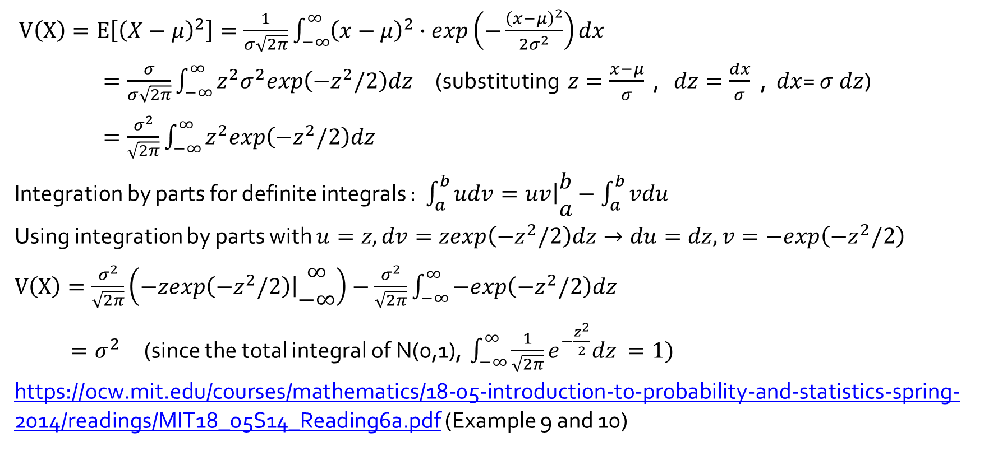
Variance of Normal Distribution**
$V\left(X\right)=E\left[{\left(X−μ\right)}^{2}\right]=\frac{1}{σ\sqrt{2π}}\int_{−∞}^{∞}{{\left(x−μ\right)}^{2}∙exp\left(−\frac{{\left(x−μ\right)}^{2}}{2σ^{2}}\right)dx}$
$=\frac{σ}{σ\sqrt{2π}}\int_{−∞}^{∞}{{z^{2}σ}^{2}exp\left(−z^{2}/2\right)dz }$ (substituting $z=\frac{x−μ}{σ}$ , $dz=\frac{dx}{σ}$ , $dx$= $σ$ $dz$)
$=\frac{σ^{2}}{\sqrt{2π}}\int_{−∞}^{∞}{z^{2}exp\left(−z^{2}/2\right)dz }$
Integration by parts for definite integrals : $\int_{a}^{b}{udv}=\left.uv\right|\begin{matrix}b \\ a\end{matrix}−\int_{a}^{b}{vdu}$
Using integration by parts with $u=z, dv=zexp\left(−z^{2}/2\right)dz→du=dz, v=−exp\left(−z^{2}/2\right)$
$V\left(X\right)=\frac{σ^{2}}{\sqrt{2π}}\left(\left.−zexp\left(−z^{2}/2\right)\right|\begin{matrix}∞ \\ −∞\end{matrix}\right)−\frac{σ^{2}}{\sqrt{2π}}\int_{−∞}^{∞}{−exp\left(−z^{2}/2\right)dz }$
$=σ^{2}$ (since the total integral of N(0,1), $\int_{−∞}^{∞}{\frac{1}{\sqrt{2π}}e^{−\frac{z^{2}}{2}}dz }=1)$
https://ocw.mit.edu/courses/mathematics/18-05-introduction-to-probability-and-statistics-spring-2014/readings/MIT18_05S14_Reading6a.pdf (Example 9 and 10)

